Slide 1
OVERVIEW OF PARALLEL PROCESSING
• It is the technique which provides simultaneous data processing for the purpose of increasing the computational speed of a computer system
• Parallel processing can be achieved by
multiple functional unit that perform identical or different operations simultaneously.

Slide 2
OVERVIEW OF PARALLEL PROCESSING ………….
• Parallel processing is established by distributing the data among the multiple functional units.
Example : Arithmetic , logic , and shift operations can be separated into three units and operand diverted to each unit under the supervision of a control unit.

Slide 3
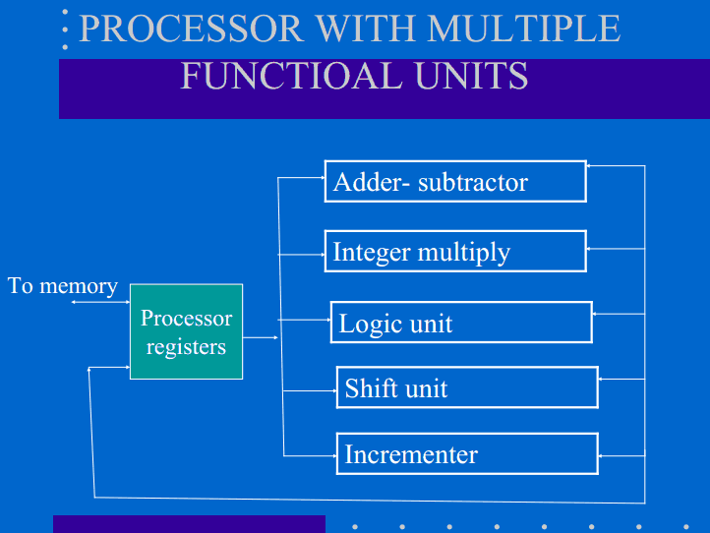
PROCESSOR WITH MULTIPLE FUNCTIOAL UNITS

Slide 4
FLYNN CLASSIFICATION :
• He classified according to the number of instructions and items that are manipulated simultaneously.
Single instructions stream , single data stream (SISD): It represents the organization of a single computer containing a single control unit , single processor unit , single memory unit.

Slide 5
FLYNN CLASSIFICATION :
Single instruction stream, multiple data stream (SIMD): It represents the organization that includes the multiple processing units under the supervision of common control unit.
• Multiple instruction stream ,single data stream (MISD): Only theoretical interest.
• Multiple instruction stream , multiple data stream (MIMD)
>Capable of processing several programs at the same time.
>It includes multiprocessor and multi computing system.

Slide 6
Various types of parallel processing
• Parallel processing can be achieved by following main processing .
Pipeline processing.
Vector processing .
Array processing.

Slide 7
Pipeline processing
Deffinition 1:
Pipelining is a technique of decomposing sequential process into sub -operations with each sub process being executed in a special dedicated segments that operates concurrently with all other segments.
Definition2 :
It is collection of processing segments through which binary information flows.• Example : Implementation of combined multiply and add operations with a stream of number.
Ai * Bi + Ci for i=1,2,…..,7

Slide 8
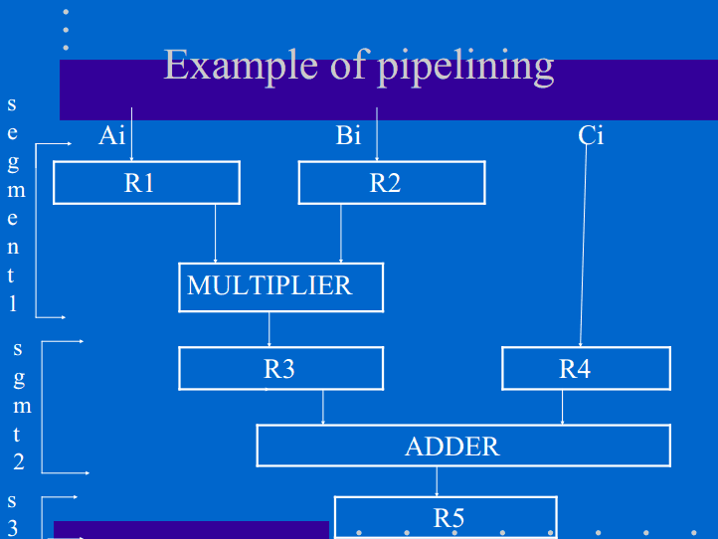
Example of pipelining

Slide 9
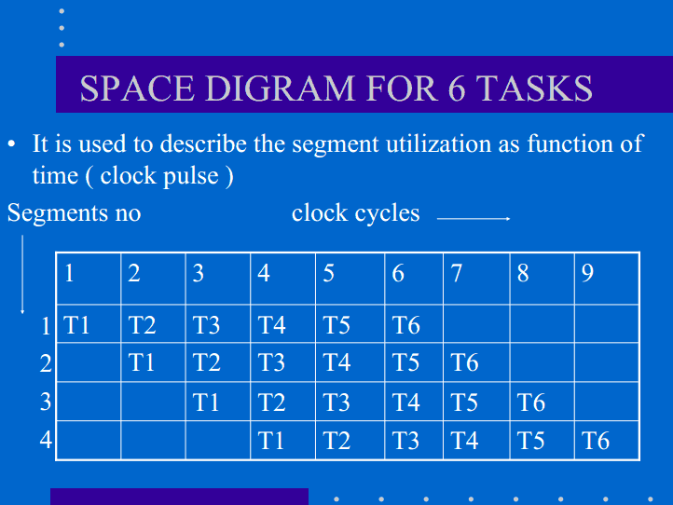

Slide 10
SPEEDUP OVER SEQUENCIAL PROCESS
Speedup : speedup S= (n * Tn) / (k+n-1)tp
Where Tn=time taken by non pipeline for each task
Tp=time for each clock pulse.
If n >>>> k-1 then
S= Tn / Tp
If for each task, time for non pipe line= pipe line
>1st task of pipe line takes k * Tp
>> non pipe line each task will take Tn= k * Tp
Speedup= k * Tp /Tp =k

